Slide 1
Debugging
PN4106

Slide 2
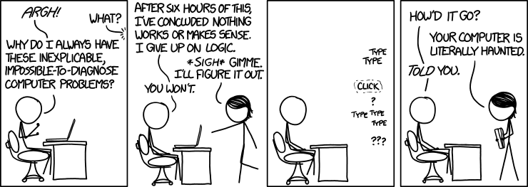
Nobody Writes Perfect Code

Slide 3
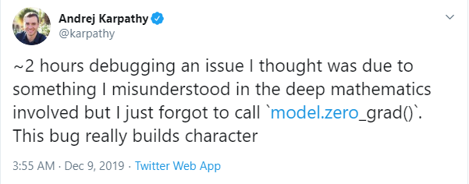
Nobody Writes Perfect Code

Slide 4
Nobody Writes Perfect Code
AI Director at Tesla

Slide 6
What to do when things aren’t working
Debugging
It’s a skill that takes practice.
Many people when starting try making random changes to get things working
Experienced coders will use systematic investigations.

Slide 7
Know What It’s Supposed to Do
The very first step. Know what you want to do.
Yes. The first instinct is it’s broken. It won’t work.
Think about what the program should be doing, what you expect the output to be.

Slide 8
Make Sure you’re Debugging the Right Problem
It’s really easy to mislead yourself into thinking the problem is caused by one thing when it’s really caused by another.
Find the right problem.
Often early errors happen that work for a little while and cause the problem later in the code.
Separate code into smaller chunks
Debug smaller sections

Slide 9
Use debugging tools
These help to step through and trace the flow making sure each step is what you expect it to be
You can set “breakpoints” that pause execution of code
You can inspect the value of variables
You can add temporary code to give outputs

Slide 10
Use debugging tools
Enable the debugger, then open the debug panel.
They all are little “bug” icons.

Slide 11
Use debugging tools
Enable the debugger, then open the debug panel.
They all are little “bug” icons.

Slide 12
Use debugging tools

Slide 13
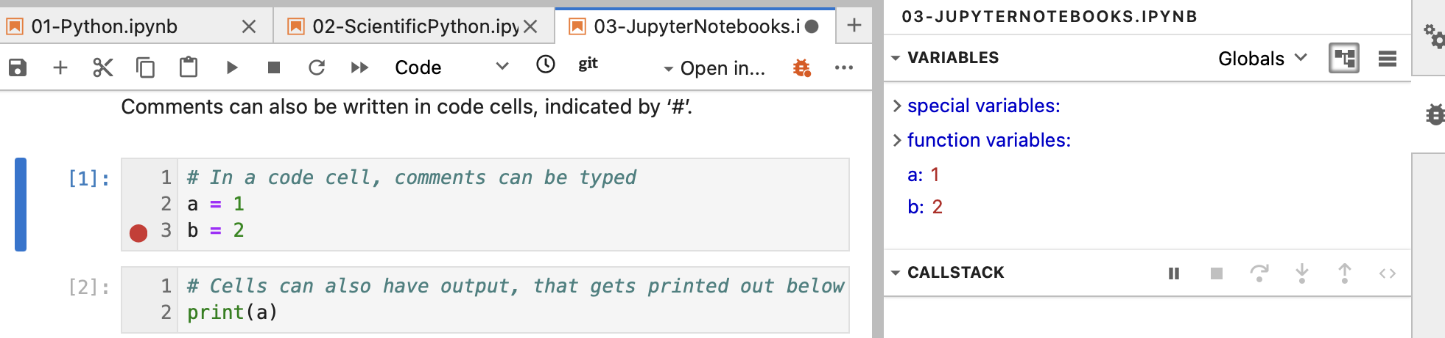
Shows the current variables and their values

Slide 14
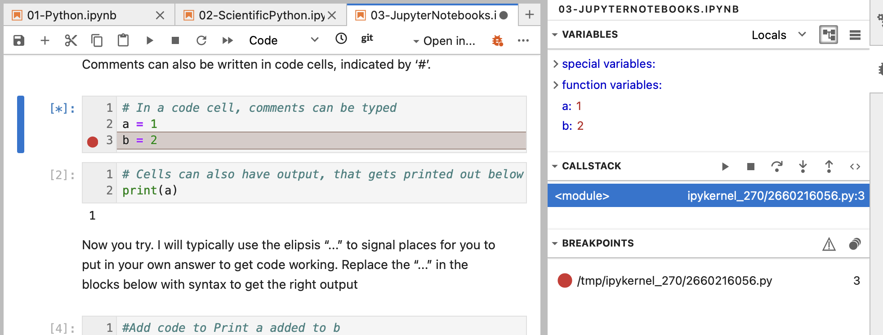
Breakpoint: Pauses code execution right before the code line is executed

Slide 15
Breakpoint: This button executes one line of code at a time. Useful to check if each step is doing what you expect

Slide 16
Change One Thing at a Time, For a Reason
Replacing random chunks of code is unlikely to do much good.
(After all, if you got it wrong the first time, you’ll probably get it wrong the second and third as well.)
Make changes for a Reason. Either to:
Gather more information (e.g. is bug still here if I do X)
Test a potential fix
Use test inputs (e.g. smaller/simpler things)
Use breakpoints to inspect what your code is doing

Slide 17
Don’t be scared to read the traceback
Read from the bottom .

Slide 18
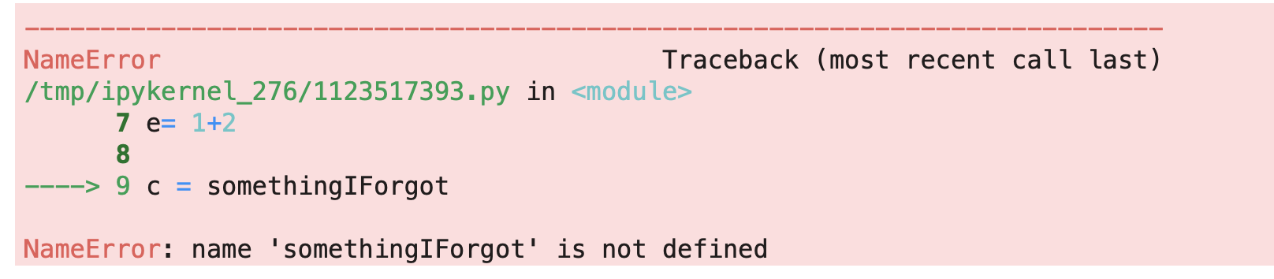
Don’t be scared to read the traceback

Slide 19
Don’t be scared to read the traceback
Type of Error

Slide 20
Don’t be scared to read the traceback
Error message
Type of Error

Slide 21
Don’t be scared to read the traceback
RealPython website has nice explanations of what each error type means:
https://realpython.com/python-traceback/

Slide 22
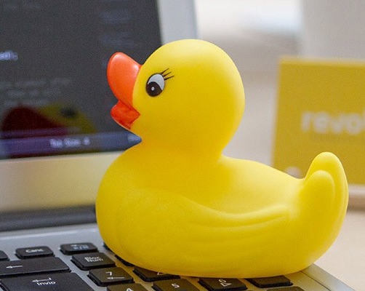
Rubber Duck Debugging
Place rubber duck on desk and inform it you are just going to go over some code with it, if that’s all right.
Explain to the duck what your code is supposed to do, and then go into detail and explain your code line by line.
At some point you will tell the duck what you are doing next and then realise that that is not in fact what you are actually doing. The duck will sit there serenely, happy in the knowledge that it has helped you on your way.

Slide 23
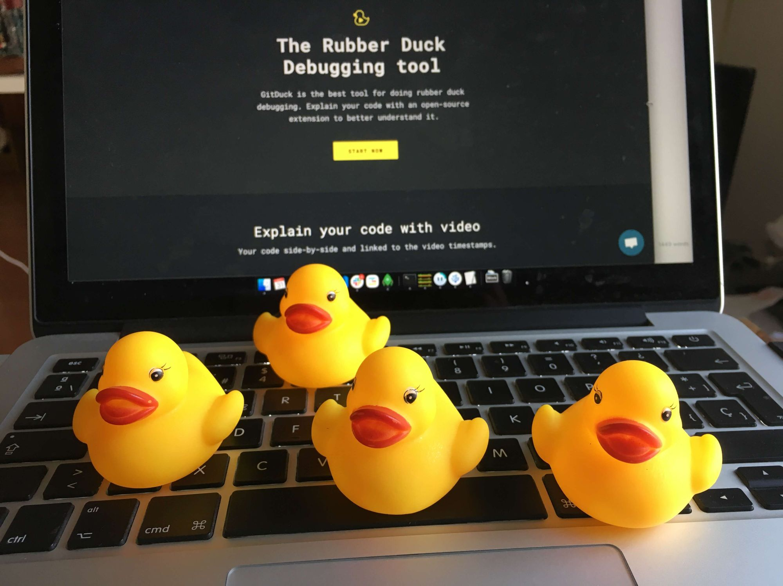
Rubber Duck Debugging
Yes. This is a real thing.
No really. I’m not joking. It is really used by professional software engineers.
https://rubberduckdebugging.com
Doesn’t have to be a duck

